Slide 1
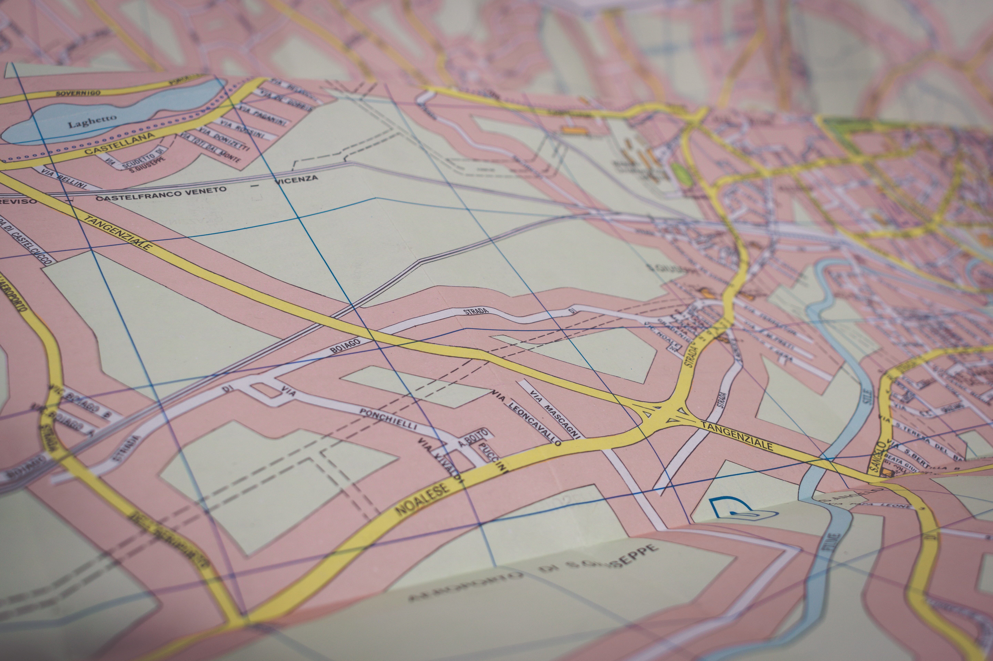

Bar-Pop
Mobile Application for Bar Populations

Slide 2
Features
Map of Nightlife Venues Near Your Location
Get Populations of People in A Venue
See Events Happening in A Venue
Add Events to Venue as Owner

Slide 3
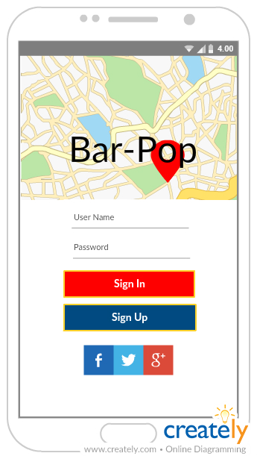
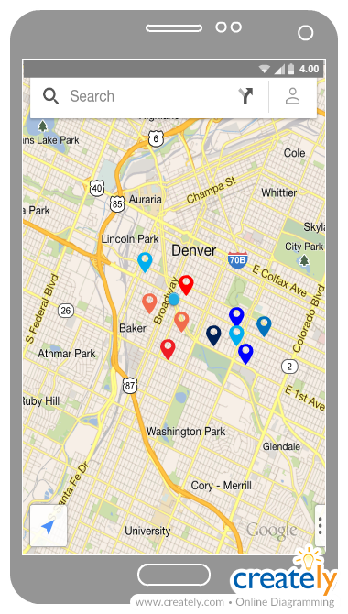
GUI
Login View
Map View

Slide 4
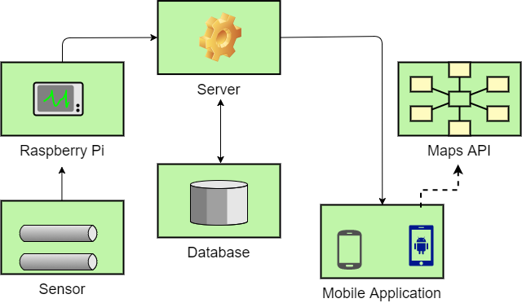
Systems Overview

Slide 5
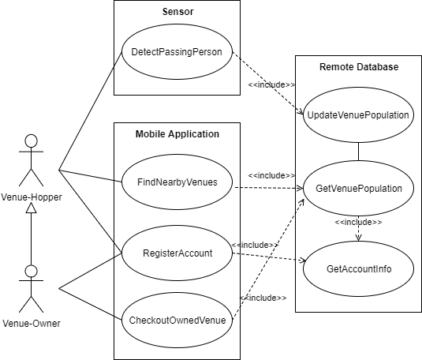
Use Case Diagram

Slide 6
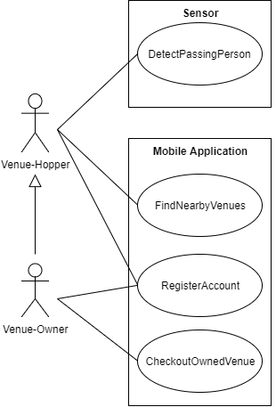
Use Case Main Flows
For
DetectPassingPerson
And
FindNearbyVenues

Slide 7
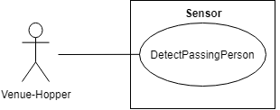
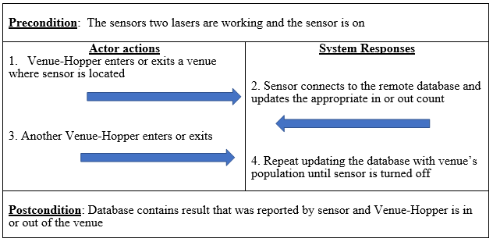
DetectPassingPerson

Slide 8
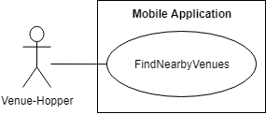
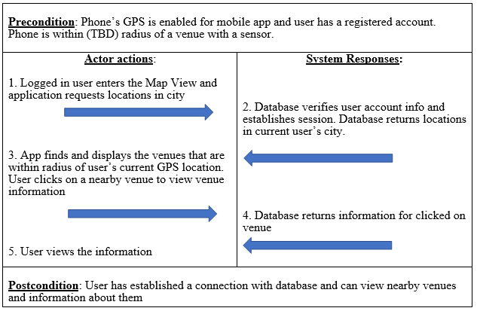
FindNearbyVenues

